Slide 1
Increment 1
Team 5 - DJ Yuhn, Stephanie Retzke, Yuxi Mao

Slide 2
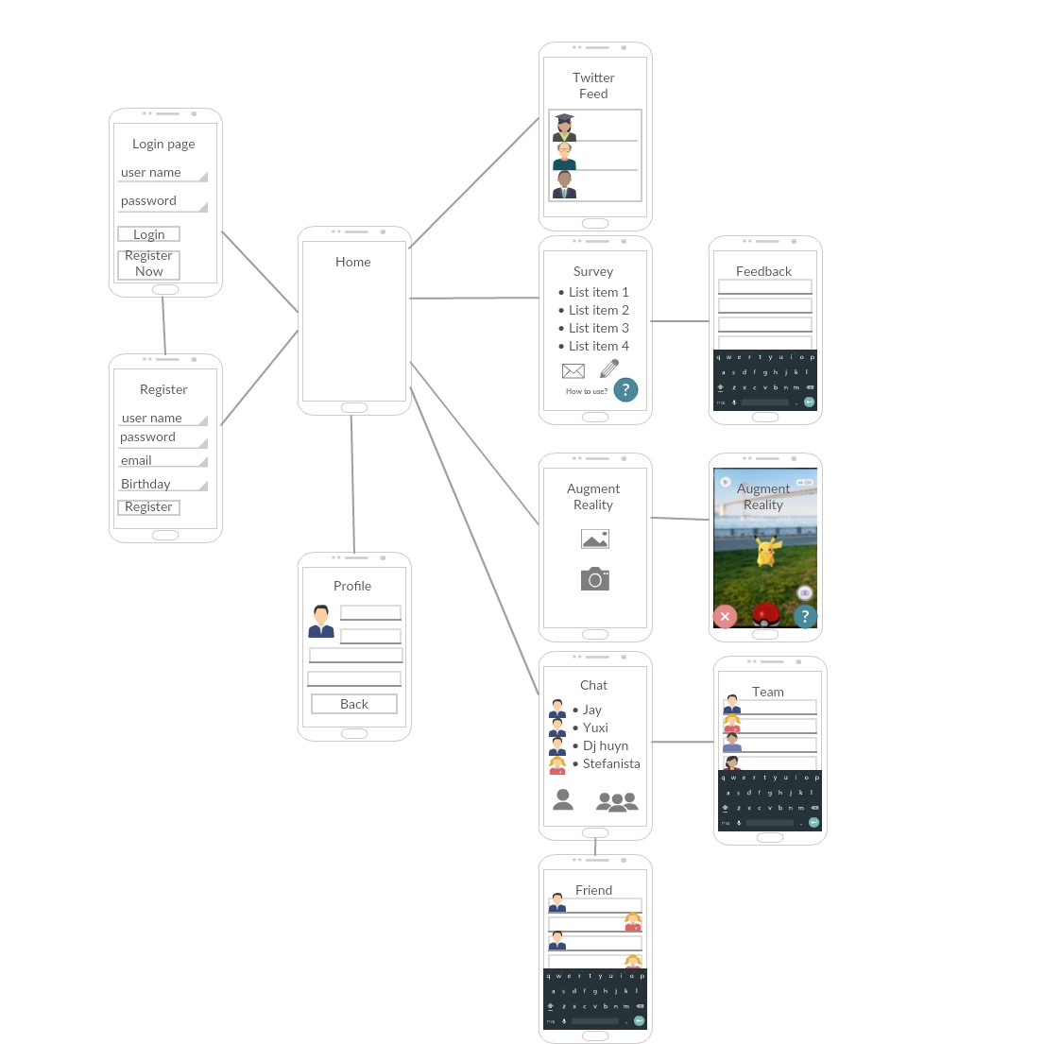
Wireframe
Users login/register
Will implement UMKC associated email
Directed to home page
Links to various pages

Slide 3
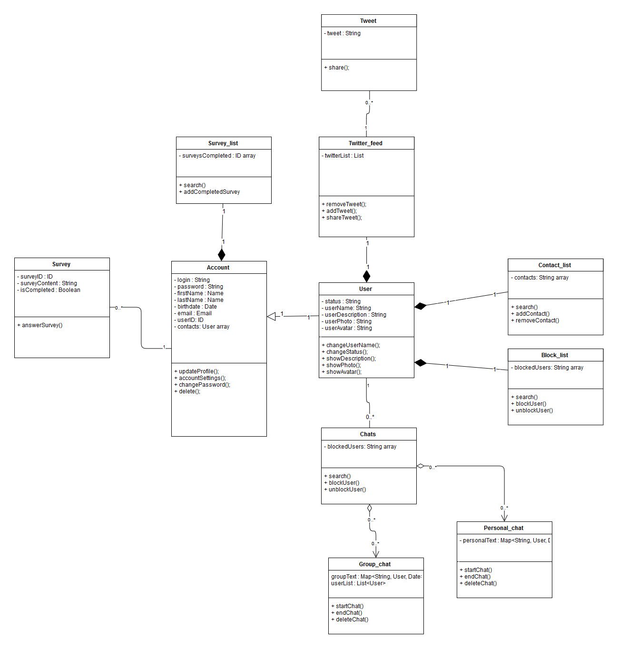
Class Diagram
Want Account separate from User
Track completed surveys on Account
Contacts, chat, and twitter specific to the User

Slide 4
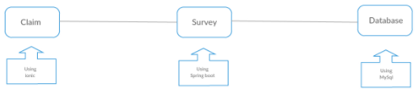
Architecture Diagram
Client uses Ionic
Cross-platform
Plugins
Server uses Spring Boot
Better Data Control
Database is MySQL
Scalable
Quicker Search
Client
Server
Database
Ionic
Spring Boot
MySQL

Slide 5
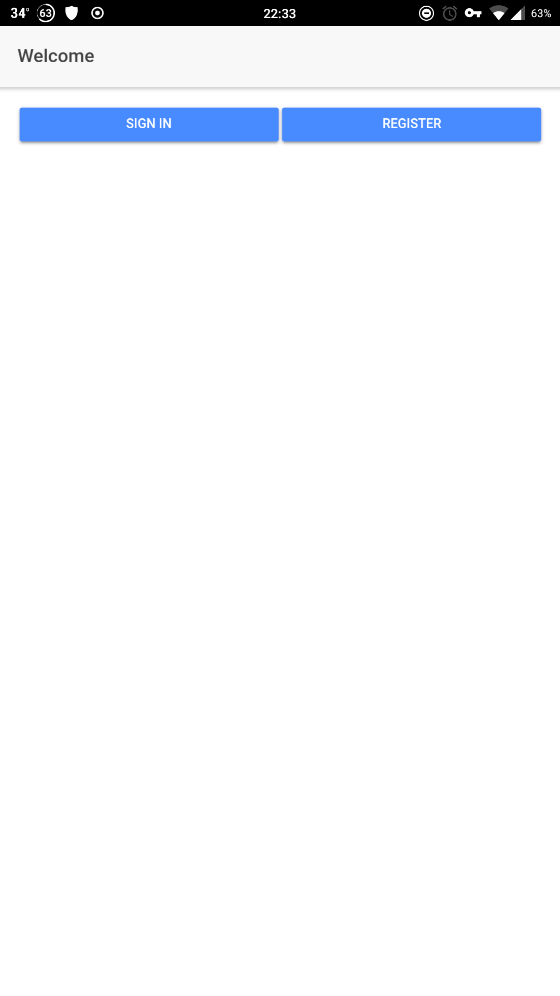
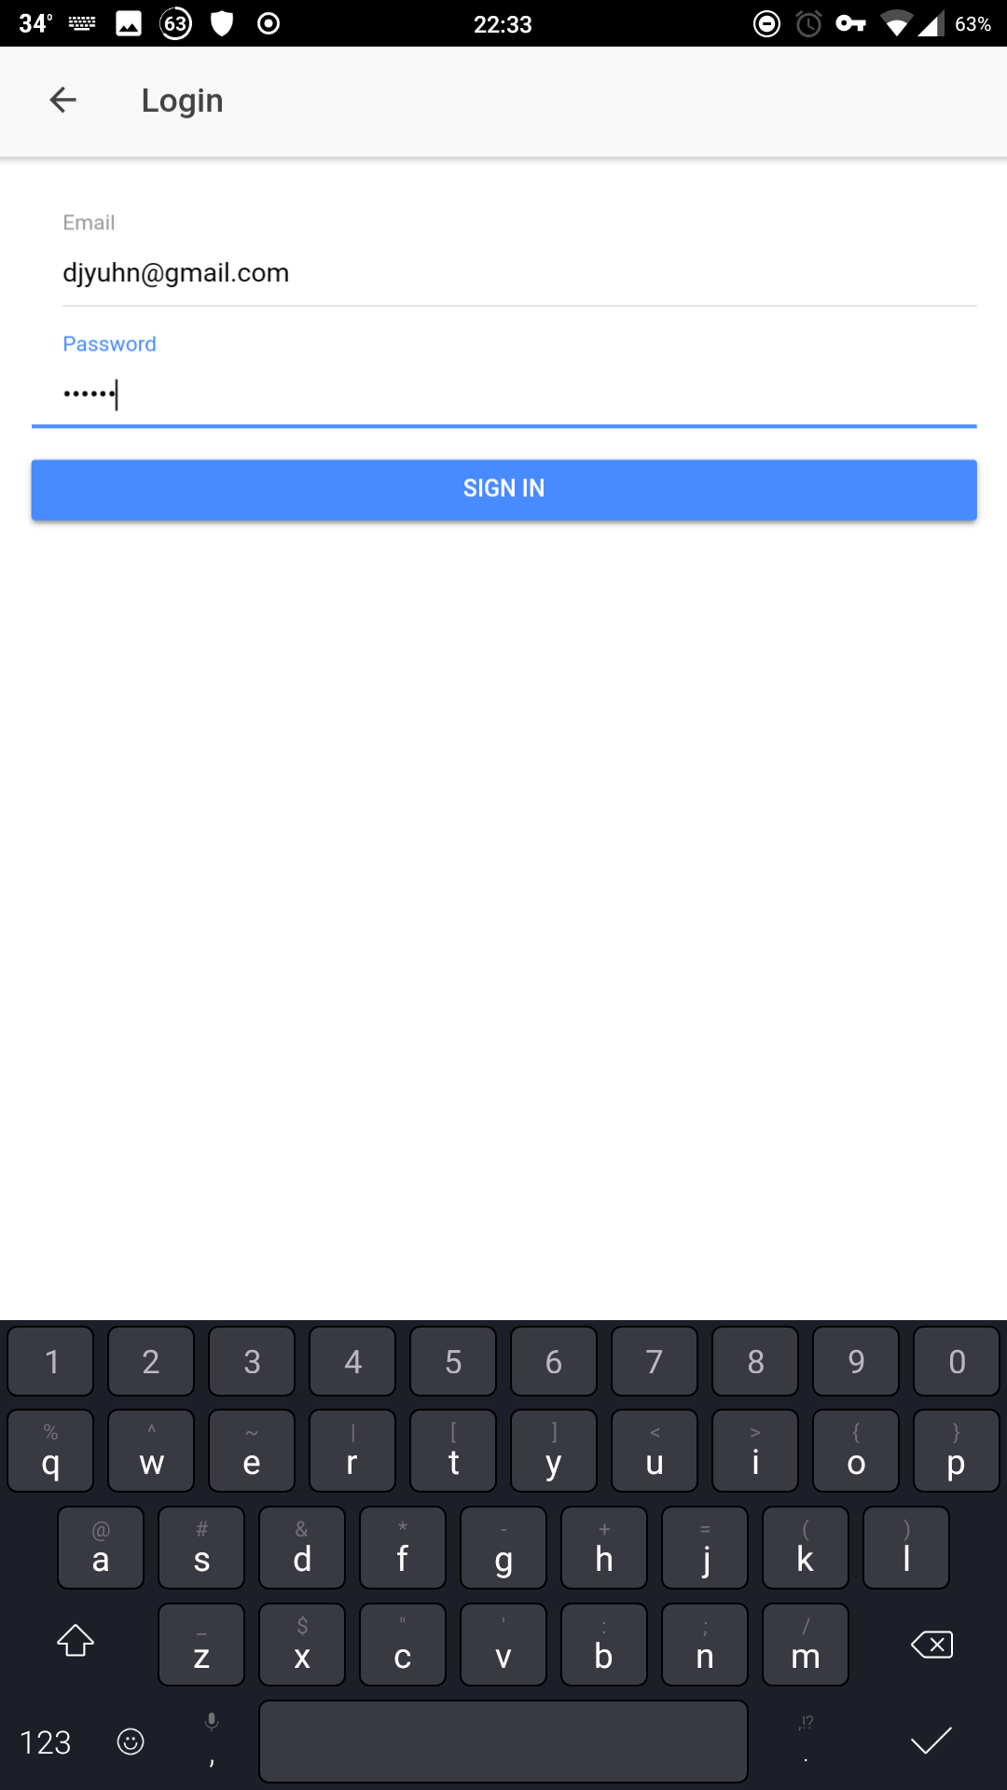
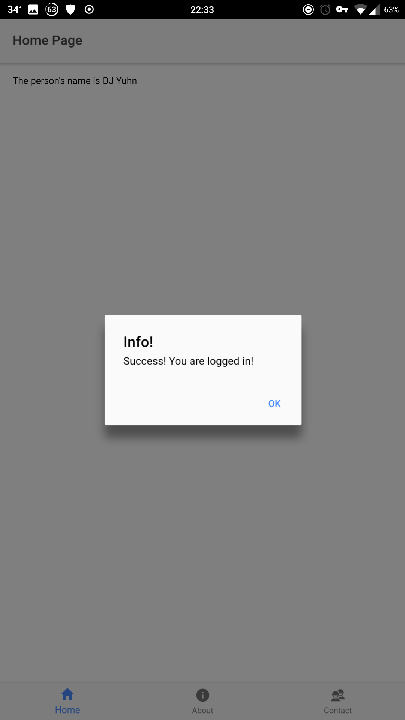
Screenshots

Slide 6
Resources
Ionic Login and Register App Tutorial Firebase Database Set Up How to display list items
How to Split a String in Typescript

